Slide 1
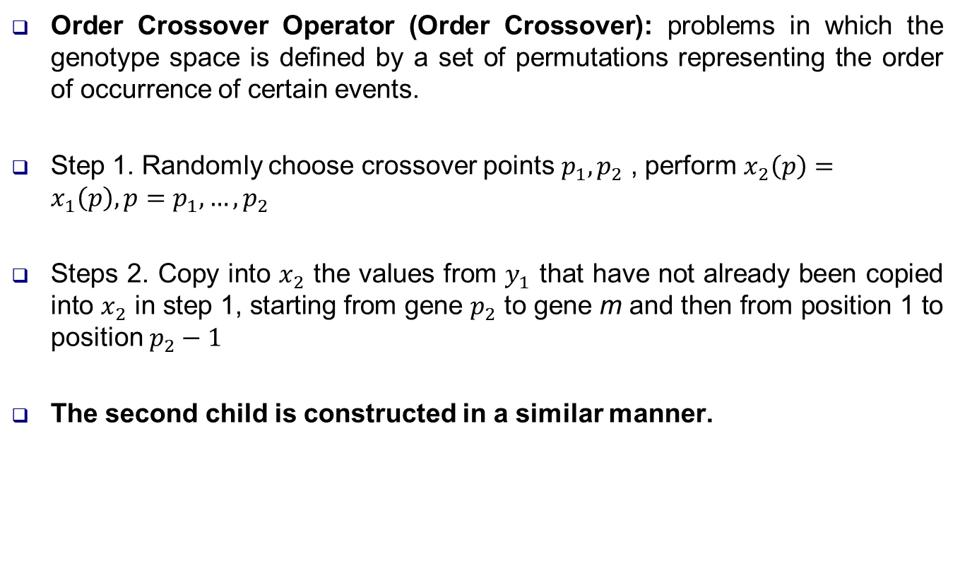
OCX Operator
Order Crossover Operator (Order Crossover): problems in which the genotype space is defined by a set of permutations representing the order of occurrence of certain events.
Step 1. Randomly choose crossover points $p_{1},p_{2}$ , perform $x_{2}\left(p\right)=x_{1}\left(p\right), p=p_{1},…,p_{2}$
Steps 2. Copy into $x_{2}$ the values from $y_{1}$ that have not already been copied into $x_{2}$ in step 1, starting from gene $p_{2}$ to gene m and then from position 1 to position $p_{2}−1$
The second child is constructed in a similar manner.

Slide 2
Example
m=10, p1=4, p2=7
(4,10,1,7,8,2,5,9,6,3)

